Slide 1
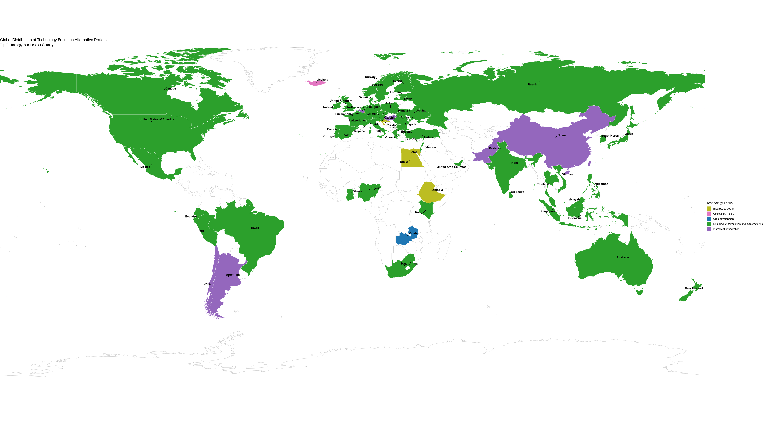

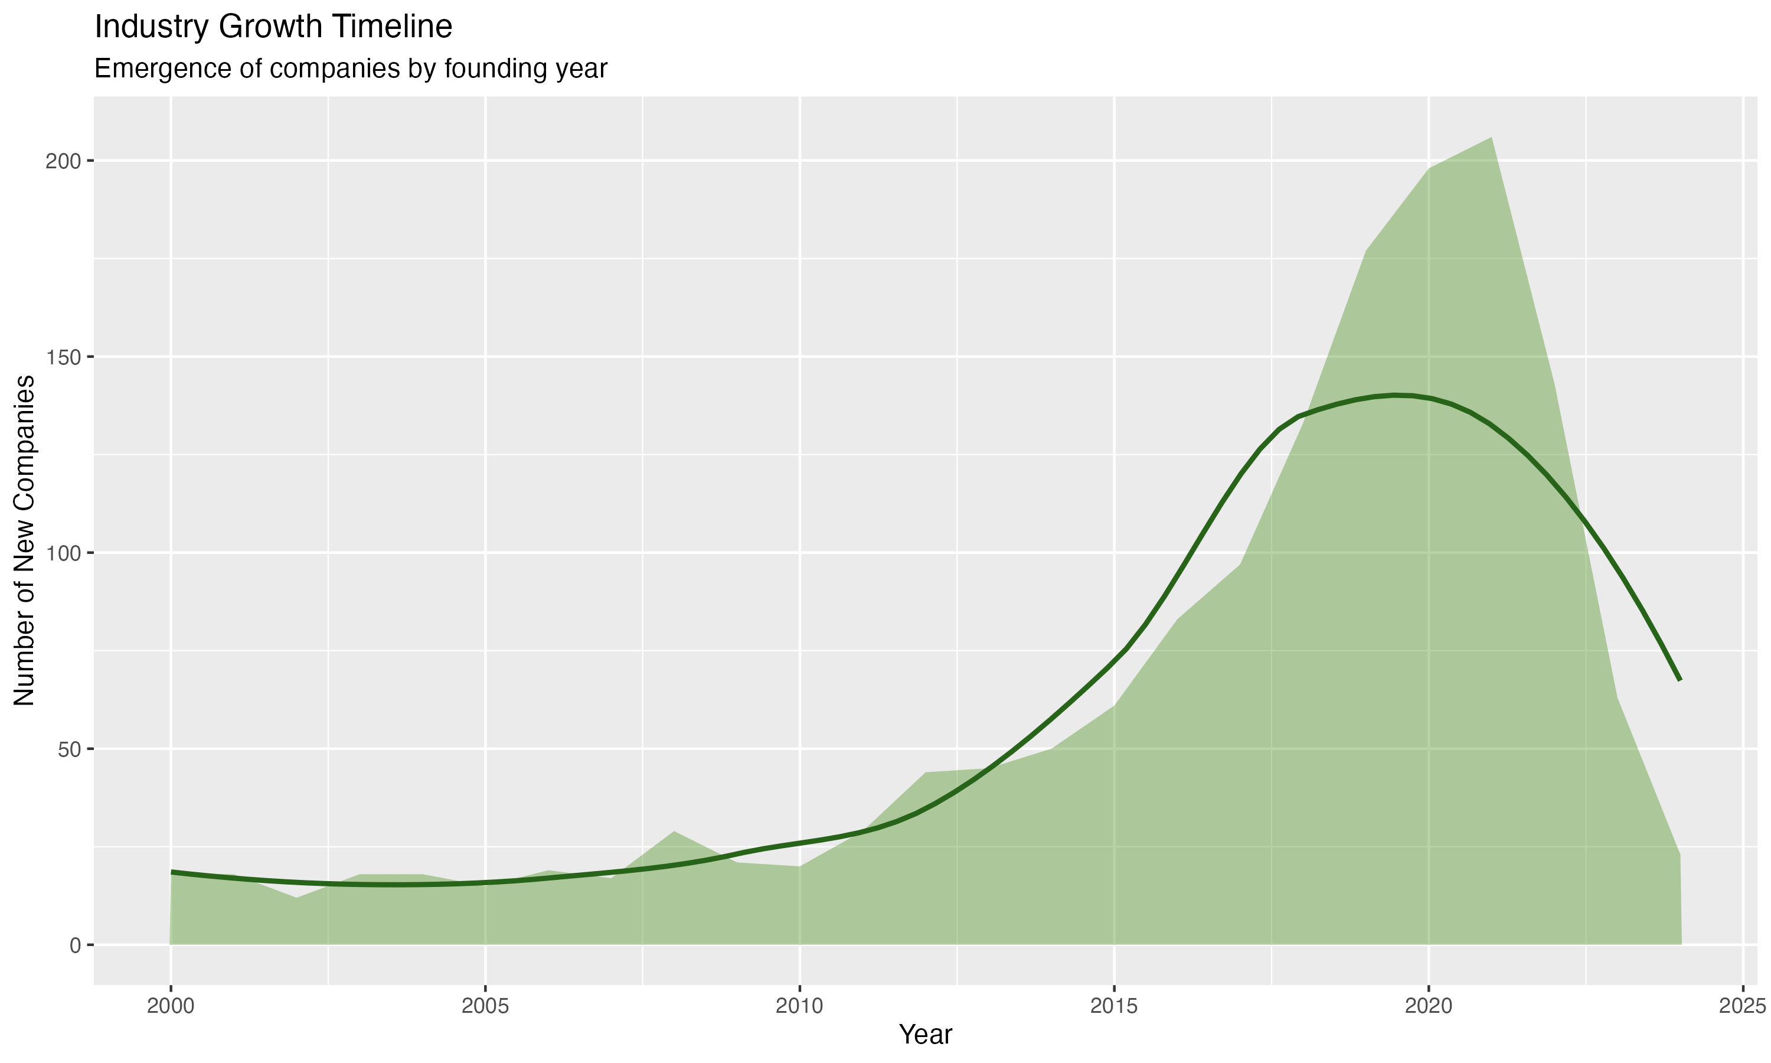
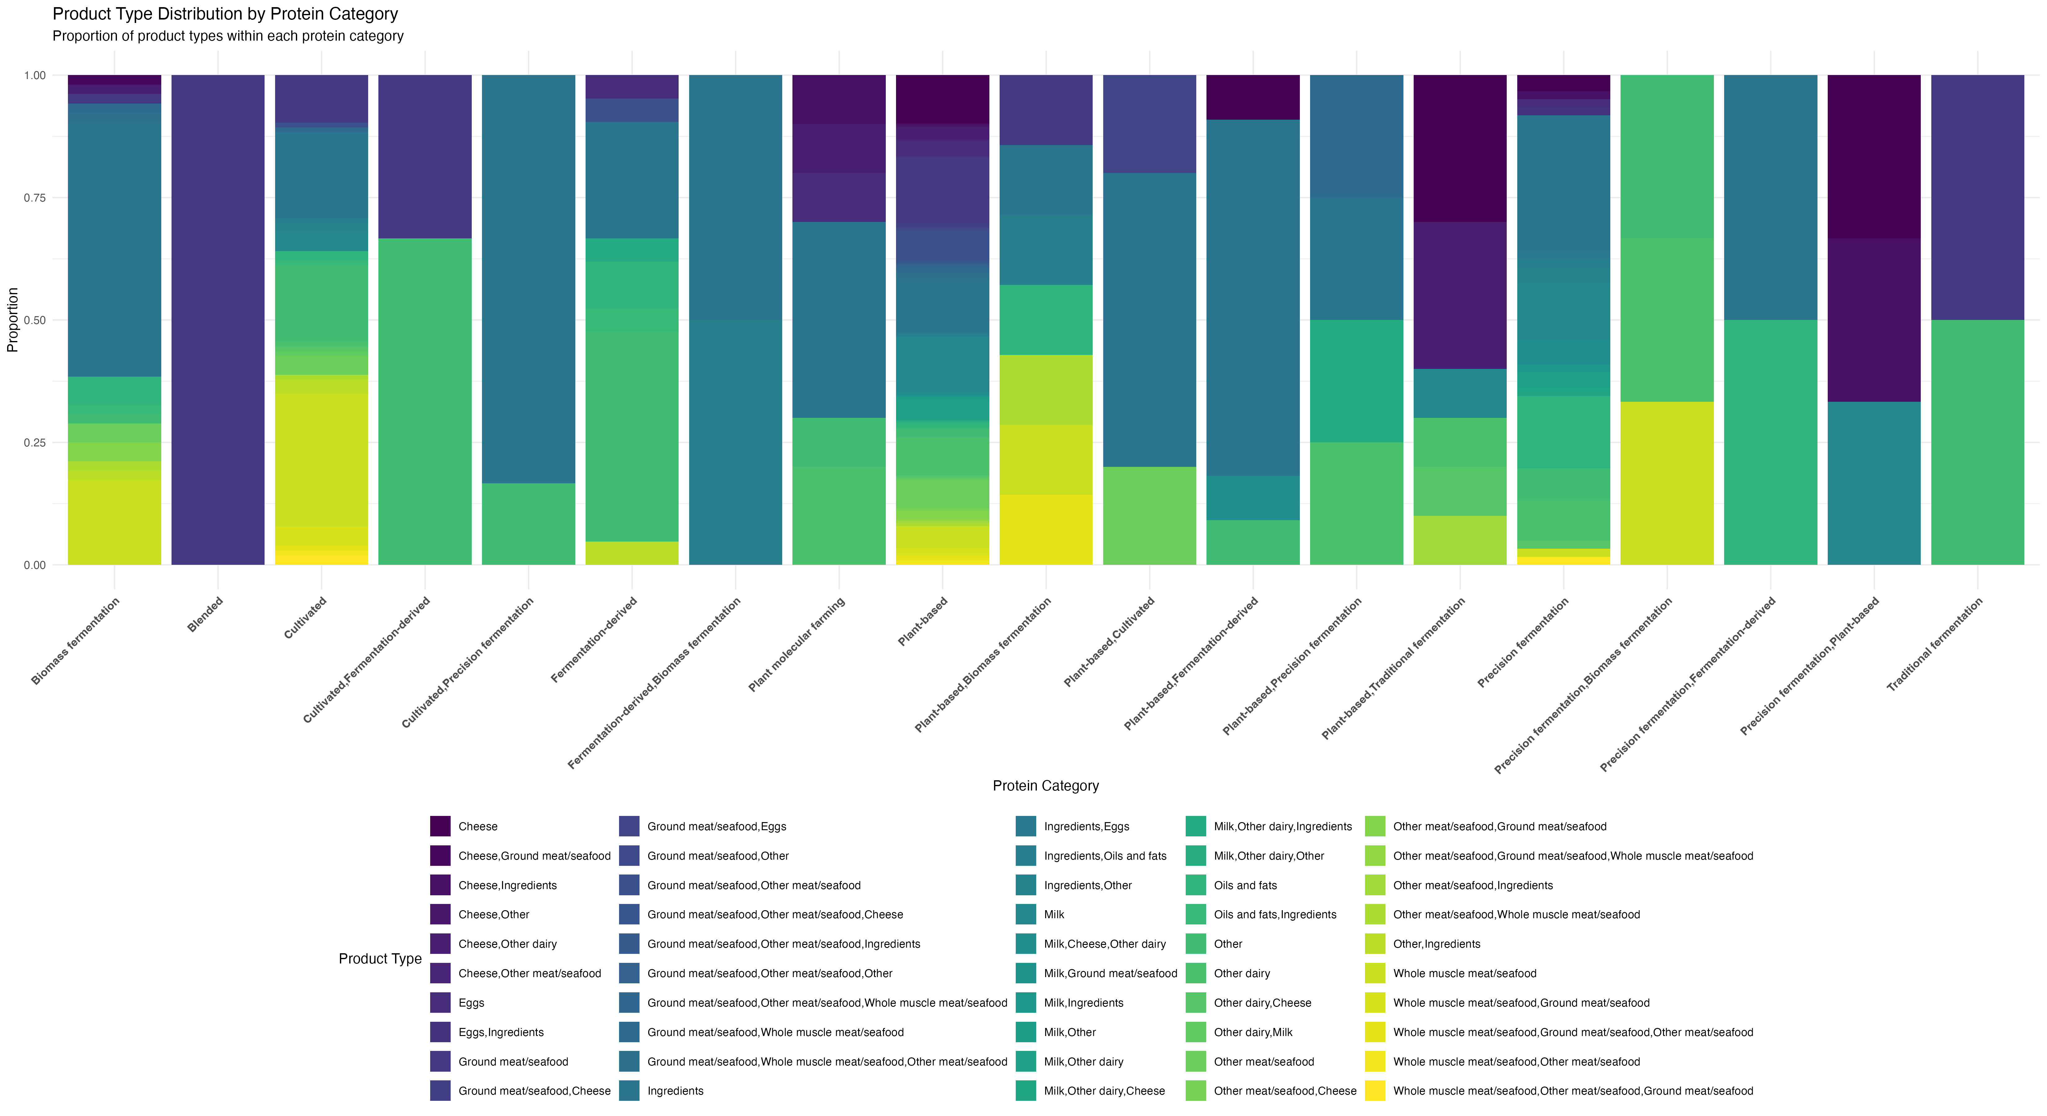
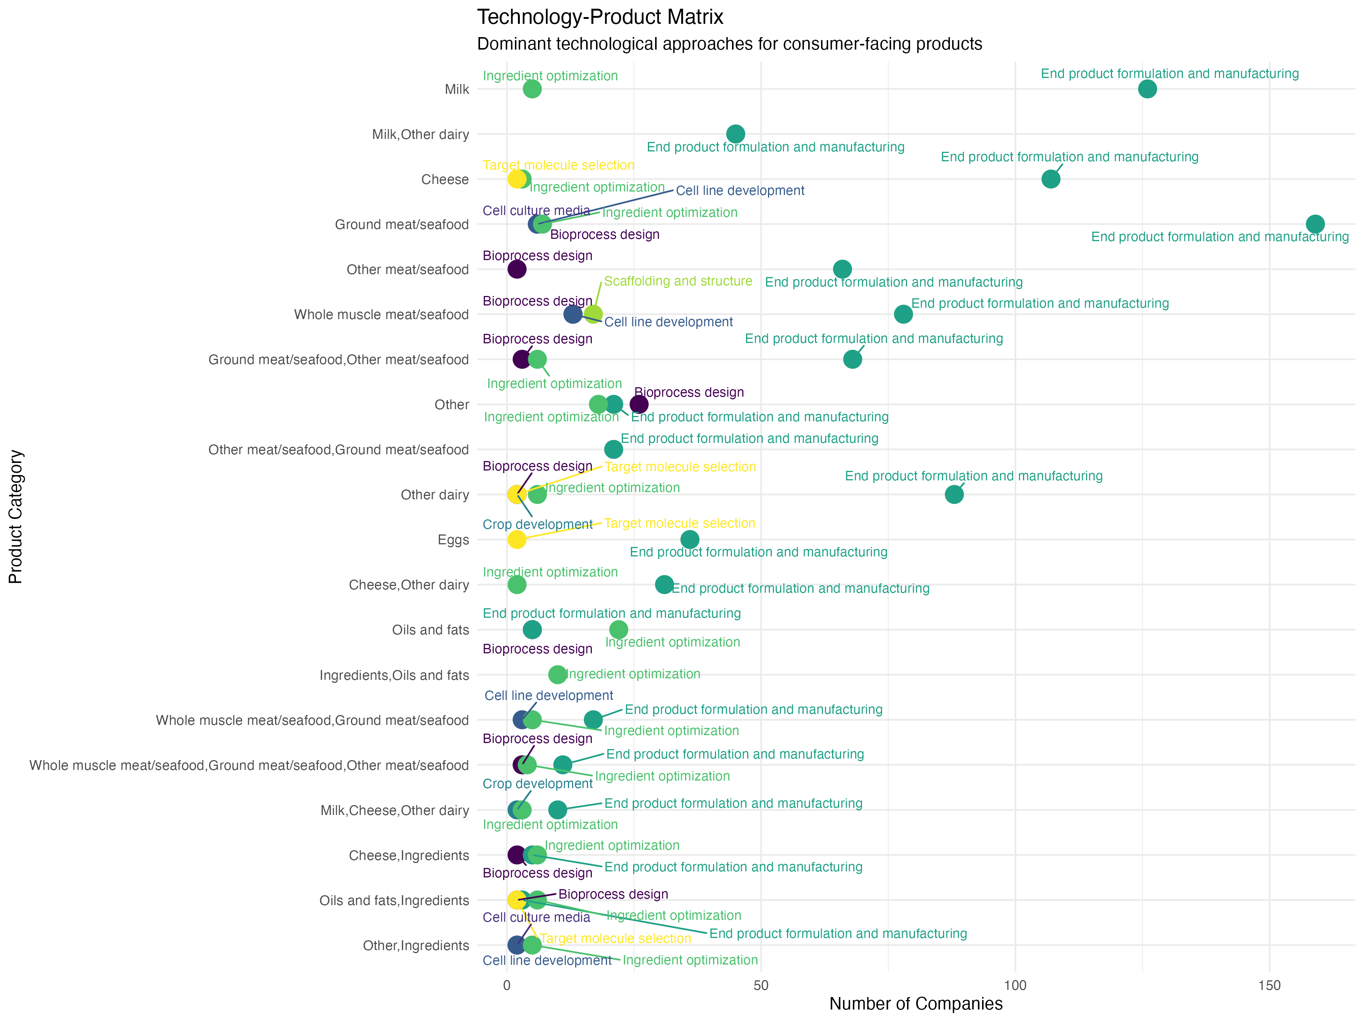
Precision fermentation leverages synthetic biology and metabolic engineering for scalable and sustainable alternative protein production
Embodied AI and multi-omics optimize microbial strain engineering and bioprocessing in precision fermentation
Metabolic burden, substrate costs, and techno-economics remain challenges with “microbial cell factories” in precision fermentation
The potential risk of nutrient inadequacies with cultured proteins may demand dietary interventions
Infrastructure, regulatory clarity, and life cycle assessments are critical for fermentation-enabled alternative protein industry growth

